Slide 1
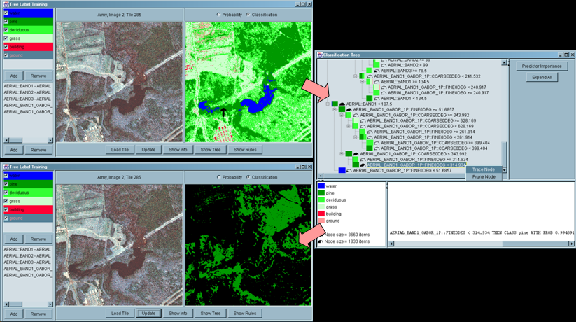
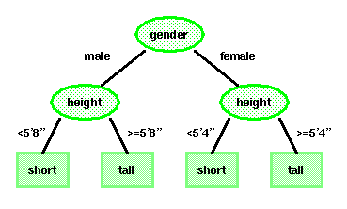

LECTURE 18: DECISION TREES
Objectives: Tree-Growing Via CART Splitting, Stopping and Pruning Attributes Node Impurity
Resources: DHS: Chapter 8 WIKI: Definitions AAAI: Decision Trees AM: Data Mining DTDM: Resources JB: Examples ISIP: Software
URL:
Audio:
Notes:
MS Equation 3.0 was used with settings of: 18, 12, 8, 18, 12.

Slide 2
Basic Principles
The top, or first node, is called the root node.
The last level of nodes are the leaf nodes and contain the final predicted value.
The intermediate nodes are the descendant or “hidden” layers.
Binary trees, like the one shown to the right, are the most popular type of tree.
In a binary tree, by convention if the answer to a question is “yes”, the left branch is selected.

Slide 3
Building steps
Step 1: Data is stored in the main memory and tree data structure with a single root node is initialized.
Step 2: When a new datapoint arrive: filter down the tree and put the datapoint to a leaf.
Step 3: Decide whether or not turn the leaf mentioned above into a node with children leaves.
Step 4: (If step 3 decides to split) Find the best attribute to perform the split.

Slide 4
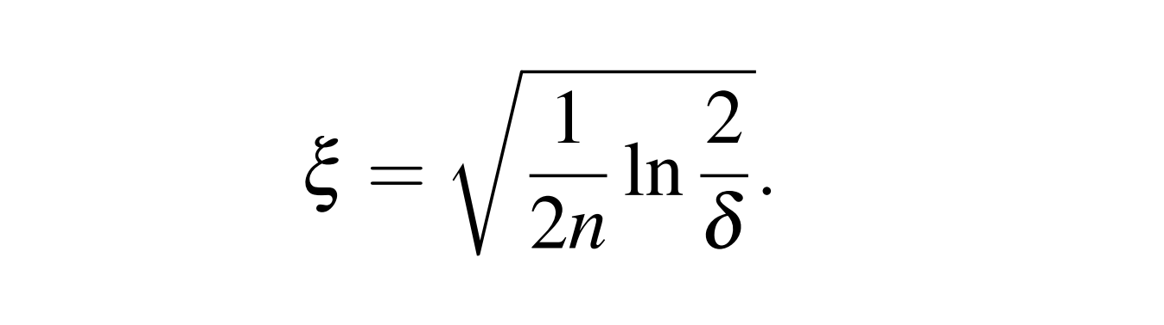
Step 3
Hoeffding bound
In some materials, there is R (range of features)
Using the bound, if G(B) – G(Sb) > epsilon, then the split is performed
G here can be considered as the VR function

Slide 5
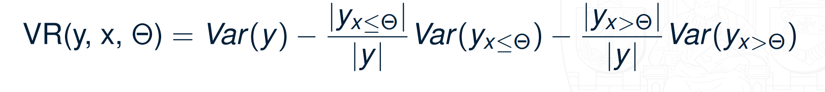
Step 4
How to split:
For each feature, try EVERY thresholds possible and take the one with the best VR value to be the candidate
For all the candidates, choose the one with the best VR value to split
VR formular:
Where: x is the feature considered, theta is the threshold considered, absolute signifies the cardinality of the set (smaller than threshold and bigger than threshold).

